Slide 1
Ggplot2 and interactive graphics with R
Christophe Ladroue
SECTION 05
VIDEO 04
Customizing the color palette for continuous data
www.PacktPub.com

Slide 2
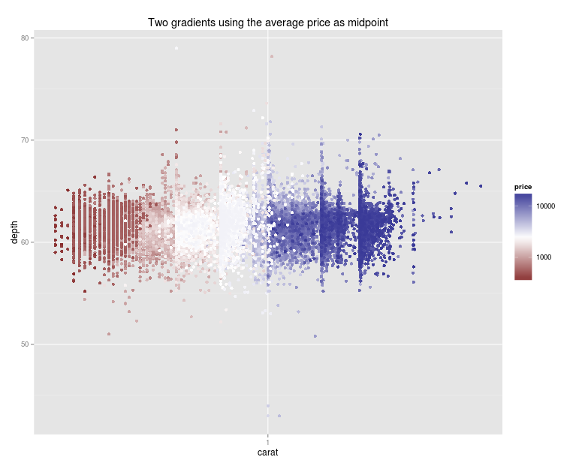
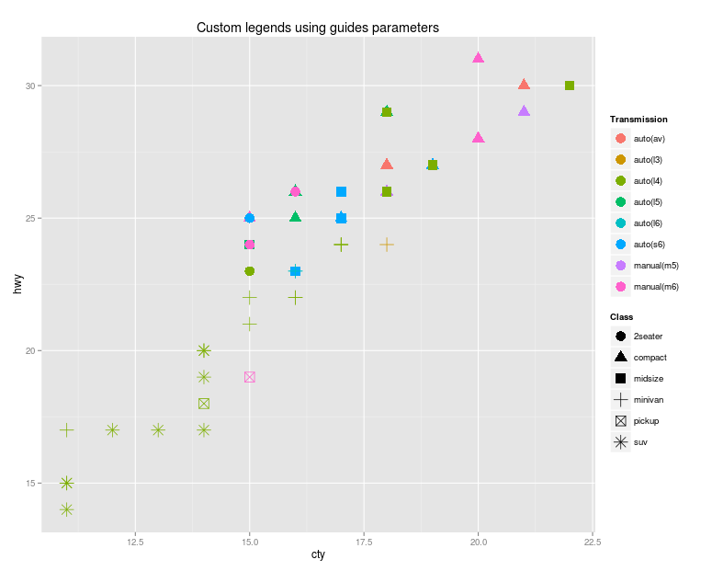
In this video we took a look at
how the default coloring works by default.
how to change the colors of the default gradient.
how to restrict the coloring to a range of values.
how to hide irrelevant data without throwing it away.
how to use multiple gradients to convey interesting information visually.
Next: legend titles, axis labels

